Slide 1
Welcome to DevOpsDC!
6:30 - 7:00: Meet, greet, and eat!
7:00 - 7:15: Intros and Announcements
7:15 - 8:45: Presentations
DevOps & Government Contracts – Tony Alletag
Improv for DevOps – Victoria Guido
8:45 - 9:00: Networking

Slide 2



Sponsors
Notes:
Excella – location
Evolenthealth.com – Food
Hobsons - drinks

Slide 3
Code of Conduct
http://www.meetup.com/DevOpsDC/pages/Code_of_Conduct/
We value the participation of each member of the community and want all attendees to have an enjoyable and fulfilling experience. Accordingly, all attendees are expected to show respect and courtesy to other attendees throughout all Meetup events.
To make clear what is expected, all delegates/attendees, speakers, exhibitors, organizers, and volunteers at any DevOpsDC event are required to conform to our Code of Conduct. Organizers will enforce this code throughout events.
Notes:
Conduct matters, so I’ll give you short, short version:
harassment-free experience for everyone, regardless of who you are
professional audience including people of many different backgrounds
Be kind to others. No smack talk

Slide 4
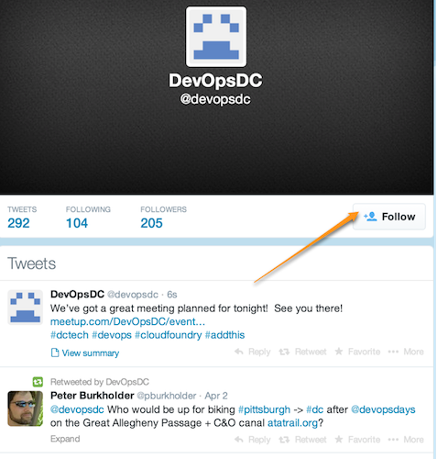
Do you even tweet?
https://twitter.com/devopsdc
Notes:
Twitter properly used is a boon

Slide 5

Slackin'…
http://www.dctechslack.com
Notes:
Now let’s talk about some upcoming events….

Slide 6
Childcare
Contact Peter….
Notes:
Now let’s talk about some upcoming events….

Slide 7

Tech Up
Notes:
http://www.susecon.com/

Slide 9
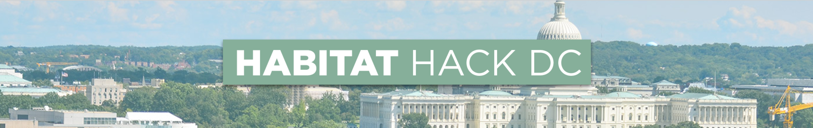


Slide 10
https://goo.gl/CqVorK

Slide 11

DevOpsDays Baltimore
March 7 & 8, 2017
http://www.devopsdays.org/events/2017-baltimore/welcome/

Slide 12
Upcoming Meetups
December 13
at Excella Consulting
Presenters:
Mark Cornick
Valiant Solutions
Notes:
We moved the November meeting from the 8th to the 15th because of election day.

Slide 13
Now it's your turn…
Hiring?
Looking for work?
Attending or speaking at a conference?
Something we all should know?
Favorite color?
Notes:
DoL Wage & Hour division: Senior Transformation Specialist, Product Manager, Software Engineer, and User Experience Designer
Last year, we put more than $246 million into the pockets of more than 240,000 workers who had been deprived of their hard-earned wages.
‣ For German Gomez, it meant finally being able to start a family after he received more than $42,000 in unpaid wages and damages following an investigation that disclosed he had been working 72 hours a week
‣ For Raquel Bruno, it meant being able to finish her degree and help her kids go to school,after the restaurant she worked for was found to owe more than $1 million to its workers.

